Slide 1
智慧型管理決策系統
2017.09.13

Slide 2
Intelligent System
Computer-aided system
Automatic 自動化
Intelligent 智慧化
Research fields
Artificial intelligence
Data mining
Machine learning
Big-data analytics
Pattern recognition
Deep learning

Slide 3

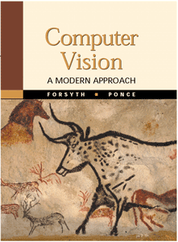
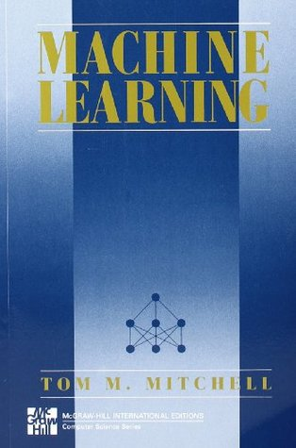

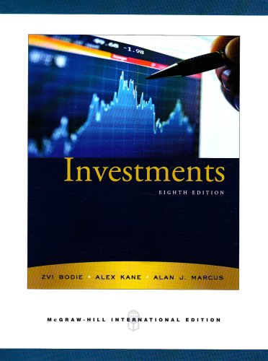
Reference books

Slide 4
Goal
Knowledge
Machine learning algorithms
Clustering
Classification
Recognition
Regression
Practices
Programming in Python
Weekly practices
Algorithm implementation
Applications
Multimedia processing (computer vision)
Financial data analysis (FinTech)

Slide 5
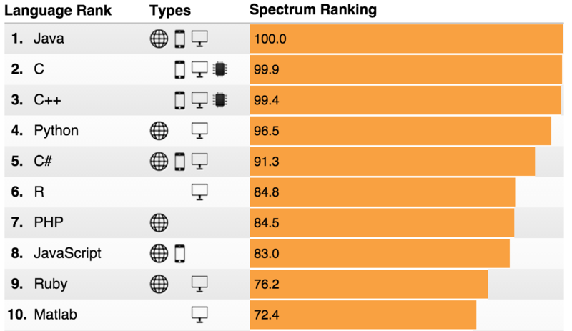
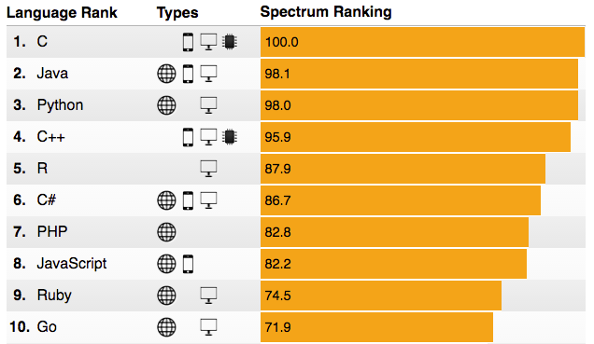
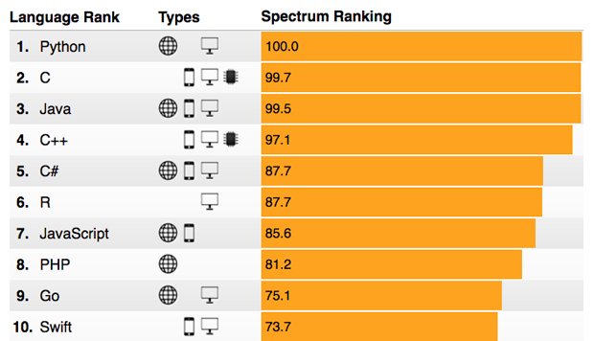
Why Python?
2015
2016
https://spectrum.ieee.org/static/interactive-the-top-programming-languages-2017
2017

Slide 6
Learning python
https://docs.python.org.tw/3/tutorial/index.html
Homework: reading Chap 1~Chap 5
https://uva.onlinejudge.org/
Register an account
Practice by yourself

